Slide 1
Mohammadmohsen AGHELINEJAD Supervisors: Dr. Yassine OUAZENE, Dr. Alice YALAOUI, Prof. Farouk YALAOUI LOSI ICD-UMR-CNRS 6281 Université de technologie de Troyes
Production scheduling of a single machine with finite states to minimize energy costs
27/09/2017

Slide 2
Index
Introduction
Problem 1: 1 (different states) |𝑠𝑒𝑞𝑢𝑒𝑛𝑐𝑒, 𝑇𝑂𝑈|𝑇𝐸𝐶
Definition
Improved model
Problem 2: 1 (different states) |$TOU$|$TEC$
Mathematical model
Proposed Heuristic and Genetic algorithms
Problem 3: 1 (different states) | $pmtn, TOU$|$TEC$
Complexity analysis with a new dynamic programming approach
Conclusions
Future Works

Slide 3
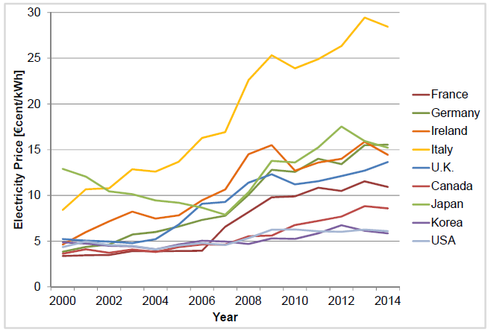
Introduction
Manufacturers are encountered with two critical issues :
more economical production in a competitive world
lack of energy resources and the desire to reduce environmental pollution
production scheduling and
energy consumption problem
Willeke et al. (2016)

Slide 4
Introduction
Literature review
Decrease energy consumption value with
total completion time : Yildirim and Mouzon (2012), Mouzon et al. (2007), Fang et al. (2011)
total tardiness : Liu and Huang (2014)
Reduce energy consumption cost or operational cost
time dependent: Tan et al. (2015), Che et al. (2016)
time dependent + machine dependent: Moon et al. (2013), (2014)
time dependent + speed dependent: Fang et al. (2014), Albers and Fujiwara (2007)
time dependent+ state dependent: Shrouf et al. (2014), Li et al. (2016)
Energy constraint: Mikhaylidi et al. (2015), Artigues et al. (2013)

Slide 5
Problem 1 (1 (different states) |𝑠𝑒𝑞𝑢𝑒𝑛𝑐𝑒, 𝑇𝑂𝑈|𝑇𝐸𝐶)
Single machine scheduling under volatile electricity price.
$T$ periods, each period p$=1,…T$characterized by its own energy cost.
$n$ jobs : each job$j=1,…n$characterized by its own processing times
non-preemption is allowed and jobs’ sequence is fixed
Start
OFF
Turn on
ON
Idle
End
Turn off

Slide 6
Problem 1: Definition
T=15, Process times= {2,1,2}
Transition time for turning on= 2
Transition time for turning off= 1
t | 0 | 1 | 2 | 3 | 4 | 5 | 6 | 7 | 8 | 9 | 10 | 11 | 12 | 13 | 14 | 15
$$c_{t}$$ | 0 | 3 | 2 | 5 | 4 | 2 | 3 | 4 | 7 | 2 | 5 | 4 | 6 | 1 | 3 | 2
OFF
$$Turn on$$
ON
$$Idle$$
$$Turn off$$
Sequence | Off | Ton | Ton | j1 | j1 | j2 | j3 | j3 | Toff | Off | Off | Off | Off | Off | Off | Off
Total energy cost= [0*(0+2+5+4+6+1+3+2)+8*(3+2)+6*(5+4+2+3+4)+1*(7)]=155

Slide 7
Initial model (Shrouf et al.(2014))
Parameters
$s$: states of machine (off, idle, on)
$n$: number of jobs
$E_{s}$: amount of energy consumption during state $s$
$E_{ss′}$: amount of energy consumption during transition $ss’$
$C_{p}$: energy cost in period $p$
$t_{j}$: processing time of job $j$
$t_{ss′}$: number of required periods for switching from state $s$ to $s’$
Decision variables
$α_{s,p}$: machine is in state s during period p
$β_{ss^{′},p}$: machine is in transition ss’ during period p
$x_{j,p}$: job j is processed during period p
$y_{j,p}$: job j begins to be processed in period p

Slide 8
Initial model (Shrouf et al.(2014))
Jobs process in a processing state
Machine has unique state during each period
Limit state of machine in each period based on the its state during previous period
identify lower and upper number of periods which the machine can be in a transition

Slide 9
Initial model (Shrouf et al.(2014))
machine can process only one job during each period
ensures processing the jobs
based on the given sequence
imposes non-preemption of the jobs
processing time of each job
all jobs must be processed during the horizon time
Boundary conditions

Slide 10
New mathematical formulation
….
j2
j2
j2
j2
3
j3
j3
j3
….
0
1
13
14
15
16
17
18
19
20
T
$x_{j,p}$: job $j$ is processed during period $p$
$y_{j,p}$: job $j$begins to be processed in period $p$
$$y_{2,13}=y_{3,18}=1$$
(just one job can be processed at a time and preemption is not allowed)
$t_{2}$=4
$x_{2,13}=x_{2,14}$=$x_{2,15}$=$x_{2,16}$=1
$y_{j,p}$: job $j$ is performing in period $p$ by the machine
$y_{2,13}=y_{2,14}$=$y_{2,15}$=$y_{2,16}=1$
This new reformulation reduces the numbers of variables by $n∗(T +1)$.

Slide 11
Improved model
(2)

Slide 12
Improved model
(8)
(9) processing the jobs based on the given order
(10) imposes non-preemption of the jobs
(11), (12) all jobs must be processed during the time limitations completely

Slide 13
Comparison results
(n, T) | $$Z_{1}$$ | $$Z_{2}$$ | ${CPU}_{1}$ (s) | $${CPU}_{2} (s)$$ | ${Gap}_{var}$(%)
(5, 30) | 322 | 322 | 0.18 | 0.12 | 22.68
(10, 50) | 788 | 788 | 5.01 | 0.83 | 31.23
(15, 70) | 1003 | 1003 | 13.21 | 1.78 | 35.70
(20, 90) | 1213 | 1213 | 110.02 | 6.38 | 38.45
(25, 110) | 1667 | 1667 | 1005.87 | 69.95 | 40.32
(30,107) | 1814 | 1814 | 2747.8 | 46.08 | 41.66
(35,126) | - | 2138 | 3600 | 491.34 | 42.68
(40,134) | - | 2504 | 3600 | 102.08 | 43.47
(45,153) | - | 2961 | 3600 | 2325.49 | 44.11
(50,172) | - | - | 3600 | 3600 | 44.64
(55,191) | - | - | 3600 | 3600 | 45.08
(60,213) | - | 4334 | 3600 | 3600 | 45.45
Cplex software
Limitation time = 3600 seconds
(n, T) | $$Z_{1}$$ | $$Z_{2}$$ | ${CPU}_{1}$ (s) | $${CPU}_{2} (s)$$ | ${Gap}_{var}$(%)
(5, 35) | 580 | 580 | 0.33 | 0.21 | 22.70
(10, 72) | 1197 | 1197 | 11.91 | 1.52 | 31.24
(15, 101) | 1769 | 1769 | 94.44 | 14.37 | 35.71
(20, 121) | 2285 | 2285 | 579.46 | 8.82 | 38.46
(25, 140) | 2683 | 2683 | 2785.4 | 29.56 | 40.32
(30,170) | - | 3281 | 3600 | 117.18 | 41.66
(35,209) | - | 4452 | 3600 | 3600 | 42.68

Slide 14
Problem 2 (1 (different states) |$TOU$|$TEC$)
How can find the optimal sequences for the machine and jobs simultaneously ?
Relaxing the related constraint.

Slide 15
Comparison results
(n, T) | ${Gap}_{z}$(%) | ${CPU}_{2}$ (s) | $${CPU}_{3} (s)$$ | ${Gap}_{cons}$(%)
(5, 30) | 1.94 | 0.372 | 0.39 | 19.16
(10, 50) | 2.65 | 2.872 | 2.312 | 48.65
(15, 70) | 1.62 | 25.93 | 63.58 | 66.62
(20, 90) | 2.49 | 257.01 | 190.23 | 76.69
(25, 110) | 2.93 | 1875.99 | 1741.72 | 82.69

Slide 16
Heuristic algorithm
The idea is to allocate the non-processing states to the extra periods by considering a specific number of Periods as initial or final Off state to decrease the possibilities.
The heuristic algorithm consist of two steps: forward and backward
Extra periods (X)= {number of periods(T) - [ transition times for Ton+ transition times for Toff+ 1 (for final state which is Off)] - sum of the processing times}
$$x=T−\left[β_{21}+β_{12}+1\right]−\sum_{j=1}^{n}{t_{j}}$$
It compares 2*(x+1) Possible solutions ((x+1) in each step), to find the best objective value and sequences.

Slide 17
Heuristic algorithm
2
21
1
….
2
0
1
2
14
15
16
17
18
19
T-1
T
2: Off 21:Ton 1:ON 12:Toff 3:Idle
2
2
21
1
….
….
2
0
2
20
T-1
T
Forward step
1
3
15
16
17
18
19
X+1
Which job?
Which state (ON/ Idle/ Midle off)?
2
2
2
….
2
21
21
1
….
2
Minimum of average energy consumption cost for each one
0
1
2
X-1
x
X+1
T-1
T
2
2
….
2
2
21
21
1
….
12
2
0
X-1
x
X+1
T-1
T
2
….
….
1
12
2
0
1
2
14
15
16
17
18
T-2
T-1
T
2
….
….
1
12
2
2
0
1
2
3
T-2
T-1
T
Backward step
X+1
.
.
.
2
2
21
….
….
1
12
2
….
2
2
2
0
1
2
T-x+1
T-1
T
2
21
….
….
1
12
2
….
2
2
0
1
T-x
T-1
T

Slide 18
Heuristic algorithm
$exp: T=14;n=3;t_{j}$={3,1,2}; X=4
0
1
2
3
4
5
6
7
8
9
10
11
12
13
14
Total energy cost
2
21
21
j2
3
3
3
3
j3
j3
j1
j1
j1
12
2
187
2
2
21
21
j2
3
3
3
j3
j3
j1
j1
j1
12
2
170
X+1
= 5
2
2
2
21
21
j1
j1
j1
3
3
j3
j3
j2
12
2
190
Forward step
2
2
2
2
21
21
j1
j1
j1
3
j3
j3
j2
12
2
175
2
2
2
2
2
21
21
j2
j3
j3
j1
j1
j1
12
2
168

Slide 19
Heuristic algorithm
0
1
2
3
4
5
6
7
8
9
10
11
12
13
14
Total energy cost
2
21
21
j1
j1
j1
j3
j3
3
3
3
3
j2
12
2
171
2
21
21
j3
j3
j2
3
3
3
j1
j1
j1
12
2
2
181
X+1
= 5
j1
2
21
21
j3
j3
j2
3
3
j1
j1
12
2
2
2
156
2
21
21
j1
j1
j1
j3
j3
j2
3
12
2
2
2
2
127
Backward step
2
21
21
j1
j1
j1
j3
j3
j2
12
2
2
2
2
2
114
$$Z_{min}=\min\left\{114,168\right\}=114$$

Slide 20
Genetic algorithm
Each chromosome consists of T+1 genes
The related number in each gene represents the machine’s state in each period
ON (>10)
OFF (1)
Ton (2)
Toff (4)
Idle (5)

Slide 21
Genetic algorithm
Generation of feasible initial population g
Roulette wheel selection
Single point crossover
Random gene selection mutation
Evaluation of each individual (Fitness)
Iteration <= MaxIter
Yes (END)
No
Selection
Crossover
Population size: 300
Number of Iterations: 300
Mutation rate: 0,15
Crossover rate:0,65
Mutation
Evaluation of children (Fitness)
Update initial population with the best children

Slide 22
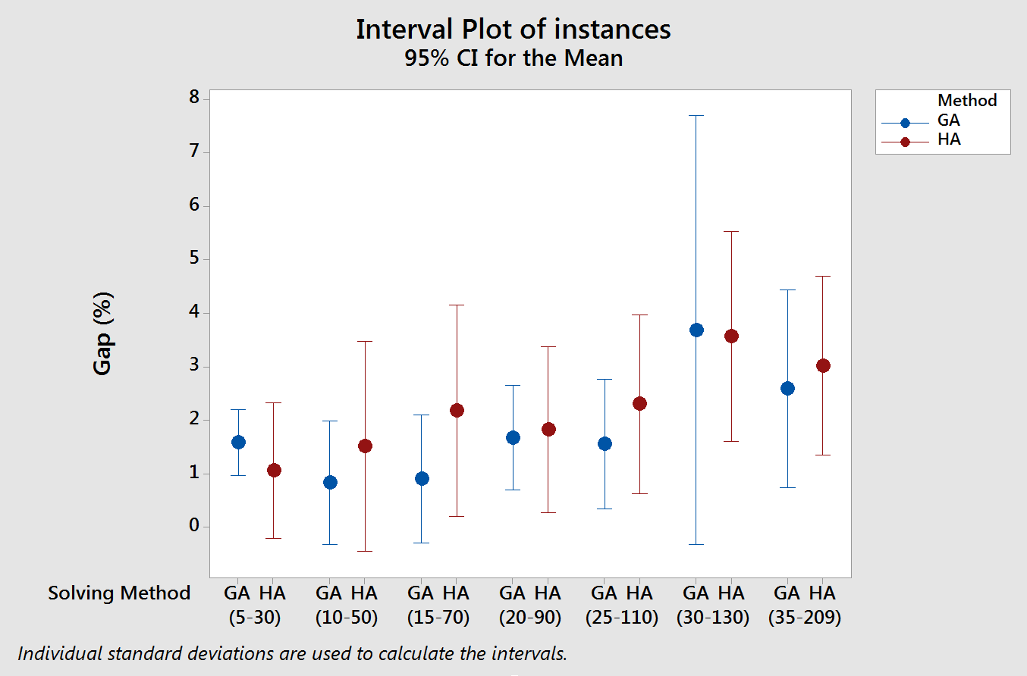
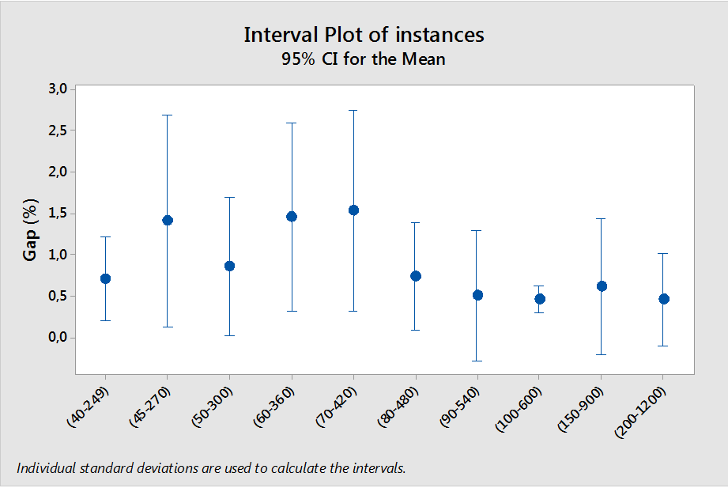
Comparison results
$${Gap}_{z1}\left(\%\right)=1,81$$
$${CPU}_{H}\left(s\right)=0,94 s$$
${CPU}_{GA}\left(s\right)=47,37$ s
$${Gap}_{z2}\left(\%\right)=1,48$$

Slide 23
Problem 3 (1 (different states) | $pmtn, TOU$|$TEC$)
Single machine scheduling under volatile electricity price.
$T$ periods, each period $t=1,…T$characterized by its own energy cost.
$n$ jobs : each job$j=1,…n$characterized by its own processing times
preemption is allowed and jobs can be process arbitrary
Start
OFF
Turn on
ON
Idle
End
Turn off

Slide 24
Problem 3: Definition
T=15, Process times= {2,1,2}
α =2, β=1
2+1+1=4=The necessary periods for initial and final set ups
4+5=9= the minimum number of periods for this example
15-9=6= x (the extra periods that machine must be in non-processing states)
t | 0 | 1 | 2 | 3 | 4 | 5 | 6 | 7 | 8 | 9 | 10 | 11 | 12 | 13 | 14 | 15
$$c_{t}$$ | 0 | 3 | 2 | 5 | 4 | 2 | 3 | 4 | 7 | 2 | 5 | 4 | 6 | 1 | 3 | 2
OFF
$$Turn on$$
ON
$$Idle$$
$$Turn off$$
Sequence | Off | Ton | Ton | job3 | job2 | job1 | job3 | job1 | Toff | Off | Off | Off | Off | Off | Off | Off
Total energy cost= [0*(0+2+5+4+6+1+3+2)+8*(3+2)+6*(5+4+2+3+4)+1*(7)]=155

Slide 25
An exact polynomial approach
Model the problem consist of T periods and P process times, by using a finite graph which is decomposed in T+1 levels and P+2 lines .
Put the nodes
Draw the edges
Calculate the edges’ value
Compute the nodes’ cost
Find the shortest path between node (0,0) and node (P+1,T) of the graph by Dijkstra’s algorithm .

Slide 26
Graph structure
T=15
P=5
X=6
t | 0 | 1 | 2 | 3 | 4 | 5 | 6 | 7 | 8 | 9 | 10 | 11 | 12 | 13 | 14 | 15
$$c_{t}$$ | 0 | 3 | 2 | 5 | 4 | 2 | 3 | 4 | 7 | 2 | 5 | 4 | 6 | 1 | 3 | 2
0
0
0
0
0
0
0
0
0
0
((3+2)*8)+(5*6)=70
100
1
8
1
1
1
1
1
4
1
Number of possible processed jobs
until period t
$$V_{\left(1,9\right)−(2,10)}$$
24
30
2
4
2
2
2
2
4
2
2
$${|E}_{2}|=\left(P+2\right)∗x$$
94
6
${|E}_{1}$|=$\left(P+1\right)∗\left(x+1\right)$
$$C_{\left(2,4\right)}$$
3
3
3
3
3
3
3
6
8
24
24
36
4
8
4
4
4
4
4
4
$${|E}_{3}|=\left(P−1\right)∗\sum_{i=1}^{x−(α+β)}{i}$$
24
6
5
5
5
5
5
5
5
$$C_{\left(6,15\right)}$$
8
2
1
3
155
$$\left|V\right|=\left(x+1\right)∗\left(P+2\right)$$
6
0
6
6
6
6
6
0
6

Slide 27
Edges’ value formulations &Recurrence relationship
$$E_{1}$$
$$E_{2}$$
$$E_{3}$$
$$A_{k,t}$$
Is set of the precedent nodes that are
connected to node (k,t) directly

Slide 28
Graph structure
t | 0 | 1 | 2 | 3 | 4 | 5 | 6 | 7 | 8 | 9 | 10 | 11 | 12 | 13 | 14 | 15
$$c_{t}$$ | 0 | 3 | 2 | 5 | 4 | 2 | 3 | 4 | 7 | 2 | 5 | 4 | 6 | 1 | 3 | 2
0
0
0
0
0
0
0
0
0
0
0
0
0
70
80
84
66
64
98
100
1
1
1
1
8
1
14
1
4
1
8
4
6
$$V_{\left(1,9\right)−(2,10)}$$
24
12
18
24
42
12
30
2
4
2
2
2
2
2
2
94
6
8
4
10
14
12
18
24
42
12
30
24
$$C_{\left(2,4\right)}$$
3
3
3
3
3
10
3
3
6
8
14
4
8
18
24
42
12
30
24
36
4
4
4
4
4
4
4
8
14
4
10
8
12
$$\left|V\right|=49$$
$$\left|E\right|=108$$
24
42
12
30
24
36
6
5
14
5
5
5
5
5
5
$$C_{\left(6,15\right)}$$
4
10
8
12
2
7
2
5
4
6
1
3
0
0
0
0
0
0
155
6
6
6
6
6
6
6

Slide 29
Complexity of Dijkstra’s algorithm
$$x=T−\left[α+β+1\right]−P$$
$\left|V\right|=\left(x+1\right)∗\left(P+2\right)$≌ TP
$\left|E\right|=$|$E_{1}$|+ |$E_{2}$|+ |$E_{3}$|
$\left|E\right|=\left(\left(P+2\right)∗x\right)+\left(\left(P+1\right)∗\left(x+1\right)\right)+(\left(P−1\right)∗[\frac{\left(x−(α+β)\right) ∗\left(x−(α+β)+1\right)}{2}$]) ≌ ${\text{T}}^{ 2}$P
Complexity= O($\left|E\right|+\left|V\right|\log\left|V\right|)=\text{O}\text{(}{\text{T}}^{ 2}\text{P}+\text{TP}\log{\text{TP}})=\text{O}\text{(}{\text{T}}^{ 2}\text{P}+\text{TP}\log{\text{T}+}\text{TP}\log{\text{P}})$
edges
vertices
O($T^{2}P)\text{≌}$ O($T^{ 3})$

Slide 30
Numerical experiments
(P,T) | $${\text{O}\text{bj}}_{Cplex}$$ | $${\text{CPU}}_{Cplex}$$ | $${\text{O}\text{bj}}_{Dij}$$ | $${\text{CPU}}_{Dij}$$
(3,10) | 108 | 1,96 | 108 | 0
(5,20) | 137 | 0,74 | 137 | 0
(16,23) | 322 | 0,21 | 322 | 0
(25,40) | 522 | 1,26 | 522 | 0
(37,48) | 789 | 0,77 | 789 | 0
(46,59) | 1032 | 0,88 | 1032 | 0
(57,72) | 1248 | 1,15 | 1248 | 0
(74,92) | 1667 | 1,59 | 1667 | 0,03
(86,107) | 1871 | 3,72 | 1871 | 0,05
(102,126) | 2204 | 1,55 | 2204 | 0,06
(119,134) | 2565 | 5,13 | 2565 | 0,03
(136,153) | 2989 | 2,89 | 2989 | 0,06
(153,172) | 3443 | 6,16 | 3443 | 0,09
(156,209) | 3433 | 5,16 | 3433 | 1,04
(177,249) | 3850 | 4,74 | 3850 | 2,12
(200,270) | 4456 | 16,86 | 4456 | 2,66
(213,300) | 4759 | 24,42 | 4759 | 4,39
(246,360) | 5366 | 12,7 | 5366 | 4,60
(280,420) | 5881 | 17,53 | 5881 | 10,04
(328,480) | 6765 | 33,83 | 6765 | 18,91

Slide 31
Conclusions
Propose a new mathematical linear programming model (first model).
simplify the basic model
reduce the number of variables and constraints
decrease calculating time
Propose the second model
obtain optimal sequence of processing jobs
reduce the number of constraints
minimize total energy costs.
Present a heuristic algorithm based on the second model
provide the optimal solutions in some examples and nearly optimal solutions in others within a few seconds.
Present a genetic algorithm.
give the better solution in most of the time in comparison to the heuristic algorithm

Slide 32
Conclusions
We proposed a new polynomial approach to model a preemptive single machine scheduling problem with state dependent and time dependent energy cost.
A finite graph is used to model the problem.
Dijkstra’s algorithm is used to find the shortest path of the graph as the optimal solution.
Since the proposed approach can model all the problem sizes in polynomial time, and the Dijkstra’s algorithm is able to find the optimal solution in a polynomial time,
These results shows that the problem is a polynomial problem (${ O (T}^{3})$)

Slide 33
Future works
Investigate the complexity of non-preemptive version of this study with different assumptions using the proposed approach or other methods
Assuming more complex problems like
variable processing speed for the machine
different energy consumptions for the jobs

Slide 34
References
[1] M. B. Yildirim and G. Mouzon, “Single-machine sustainable production planning to minimize total energy consumption and total completion time using a multiple objective genetic algorithm,” Engineering Management, IEEE Transactions on, vol. 59, no. 4, pp. 585–597, 2012.
[2] G. Mouzon, M. B. Yildirim, and J. Twomey, “Operational methods for minimization of energy consumption of manufacturing equipment,” International Journal of Production Research, vol. 45, no. 18-19, pp. 4247–4271, 2007.
[3] K. Fang, N. Uhan, F. Zhao, and J. W. Sutherland, “A new approach to scheduling in manufacturing for power consumption and carbon footprint reduction,” Journal of Manufacturing Systems, vol. 30, no. 4, pp. 234–240, 2011.
[4] A. Che, Y. Zeng, and K. Lyu, “An efficient greedy insertion heuristic for energy-conscious single machine scheduling problem under time-of-use electricity tariffs,” Journal of Cleaner Production, 2016.
[5] J.-Y. Moon, K. Shin, and J. Park, “Optimization of production scheduling with time-dependent and machine-dependent electricity cost for industrial energy efficiency,” The International Journal of Advanced Manufacturing Technology, vol. 68, no. 1-4, pp. 523–535, 2013.
[6] K. Fang, N. A. Uhan, F. Zhao, and J. W. Sutherland, “Scheduling on a single machine under time-of-use electricity tariffs,” Annals of Operations Research, pp. 1–29, 2014.
[7] F. Shrouf, J. Ordieres-Meré, A. Garcia-Sànchez, and M. Ortega-Mier, “Optimizing the production scheduling of a single machine to minimize total energy consumption costs,” Journal of Cleaner Production, vol. 67, pp. 197–207, 2014.

Slide 35
Thanks for your attention

Slide 36
Shrouf et al. 2014:
Because the shop floor scheduling problem is considered to be an NP-hard-complete problem, the formulated problem in their paper cannot be solved in real life.

Slide 37
Non-preemption constraint
$$T=10;j=1; t_{j}=3$$
Periods | 0 | 1 | 2 | 3 | 4 | 5 | 6 | 7 | 8 | 9 | 10
Machine state | 2 | 2 | 21 | 21 | 1 | 3 | 1 | 3 | 1 | 12 | 2
×

Slide 38
Future works
Complexity anaylsis of this problem with different assumptions
Considering additional assumptions
set-up time before processing each job,
stochastic job arrival,
demand of customer in each period,
energy constraints in each period
Developing proposed models and algorithms for
a multi objective problem or
more complex manufacturing system
(like parallel machine, flow shop or job shop system.)

